Slide 1

An intro to java

Slide 2
Types
This are some of the most common primitive types.
The double for numbers with decimals: 1.3, 0.0000001, 1000000.2, -1.3, etc.
The int for integers: 1, 2, 4, 1000, -190, -1, etc.
The boolean for true or false, yes or no, 1 or 0.
And the string for text.
You can interchange between int and double but the int will round up the double.
double x = 0.0;
int y = 1;
boolean bool = true;
String hello = "hello";
Type name = value;

Slide 3
Var name rules
A variable name can consist of Capital letters A-Z, lowercase letters a-z digits 0-9, and special characters such as _ underscore sign.
The first character must not be a digit.
Blank spaces cannot be used in variable names.
Java keywords cannot be used as variable names.
Variable names are case-sensitive.
There is no limit on the length of a variable name but by convention, it should be between 4 to 15 chars.
Variable names always should exist on the left-hand side of assignment operators.
https://www.geeksforgeeks.org/rules-for-variable-declaration-in-java/

Slide 4
Arrays, lists, and arrayLists
Arrays, lists, and arrayLists are literally lists of any object/type, a list of numbers would be: [1, 2, 4, 5]
A list of Strings: [“hello”, “hi”, “hello there”]
A list of lists: [[1, 2], [2, 3]], this is also called a matrix.
int numbers[] = {1, 2, 3, 5};
int numbers[] = {1,2,3,5};
double numbers[] = {1.6, 2.3, 3.2, 5.1};

Slide 5
For loops
for (initialization; boolean expression; update statement){
//Thing to do
}
For loops do things for x thing, eg:
For items on a list,
For this is true,
Etc.
It iterates through a list for a given thing.
for (int num : numbers){
System.out.println(num);
}

Slide 6
If statements
boolean thing = true;
double num = 1.3;
int num2 = 1;
String text = "hello";
if (thing) {
//things to do if true
}else if (num == 1.3) {
//things to do if true
} else {
//things to do if true
}
If statements are used to check if a certain thing is true, if a number is larger than another or if x == y, etc.
As if it was used in a sentence.
if (condition) {
Things to do
}

Slide 7
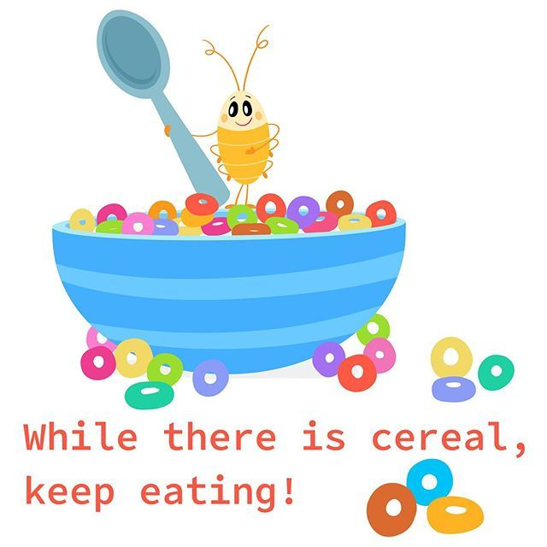
While loops
while (true) {
//things to do
}
This loop does things while the condition inside the parentheses is true
while (condition) {
Things to do
}

Slide 8
Functions
returnType name(type arguments) {
return returnType;
}
double sum(double x, double y){
return x + y;
}
double z = sum(10.1, 3.4);
This is a piece of code that can be called later. They have return types, if nothings is to be returned then the return type is void.
The arguments are used inside the function.

